Slide 1

  Área Académica: Inglés
  Tema: Sustantivos contables e incontables
  Profesor: Maricela Cruz Márquez
  Periodo: Enero – Junio 2015

Slide 2
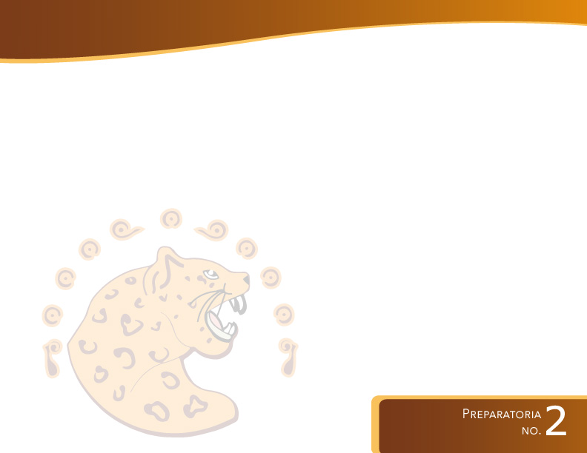
Tema:
Sustantivos contables e incontables
Abstract:
Student learns language through examples, real situations and inference of structure. They establish what they learn through grammatical exercises.

Slide 3
Tema:
Sustantivos contables e incontables
Keywords:
countable, uncountable, some, any, a-an,
how much, how many, a little, a few, much, many, a lot of, lots of.

Slide 4
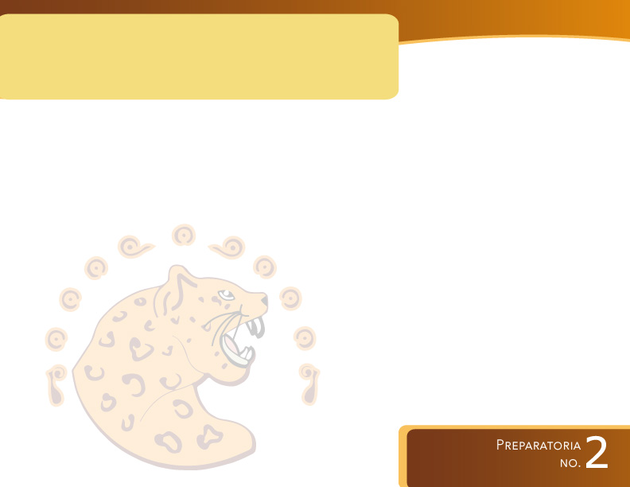
Presentation
Competencia genérica:
Escucha, interpreta y emite mensajes pertinentes en distintos contextos mediante la utilización de medios, códigos y herramientas apropiados.
Atributos:
Se comunica en una segunda lengua en situaciones cotidianas.
Competencia disciplinar extendida:
Especificar cantidades en contornos familiares e inmediatos.

Slide 5
Objective:
Students identify the use and the difference of countable and uncountable nouns, they also assume the use and structure of several quantifiers, besides they practice learning through several exercises.

Slide 6
COUNTABLE AND UNCOUNTABLE NOUNS
Countable nouns are nouns which we can count.
They have singular and plural forms.
EXAMPLES:
ONE ORANGE
TWO ORANGES
THREE ORANGES
ETC.

Slide 7
COUNTABLE AND UNCOUNTABLE NOUNS
Uncountable nouns are nouns which we cannot count.
Uncountable nouns have only singular forms.
These nouns include:

Slide 8
Uncountable nouns
FOOD: cheese, butter, salt, pepper, bread, spaghetti, etc.
LIQUID: coffee, milk, water, tea, lemonade, etc.

Slide 9

We can use the following nouns in front of some uncountable nouns to show quantity.
A bottle
A glass
A carton
A cup
A bowl
A packet
A slice
A loaf
A kilo
A bottle of lemonade
A glass of water
A carton of milk
A cup of coffee
A bowl of soup
A packet of spaghetti
A slice of bread
A loaf of bread
A kilo of cheese

Slide 10
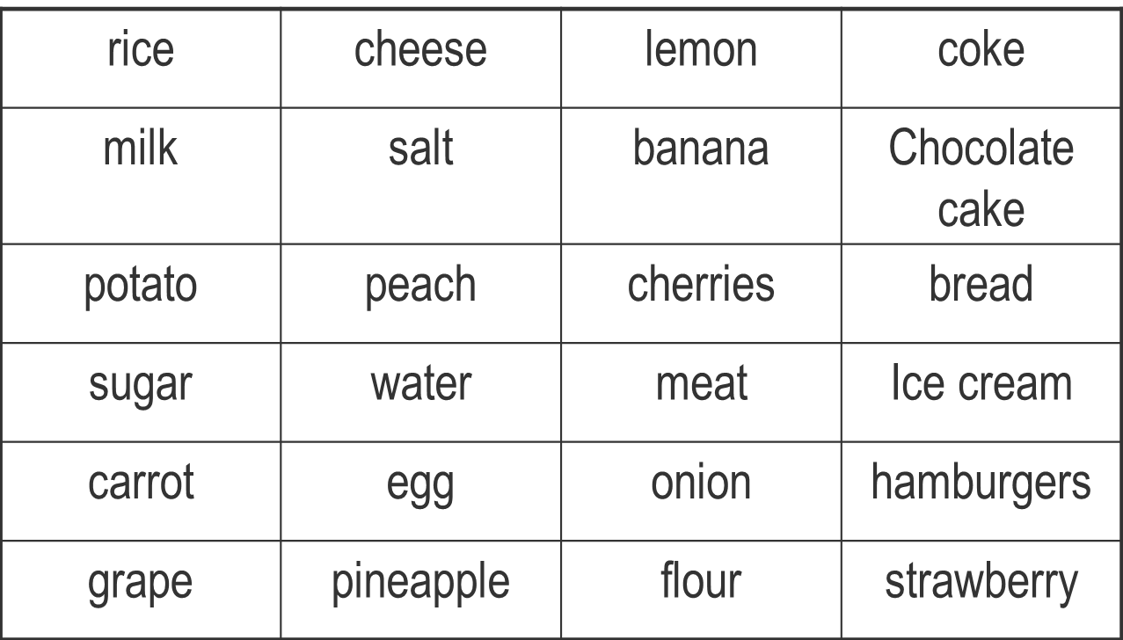
Countable or Uncountable Noun?

Slide 11
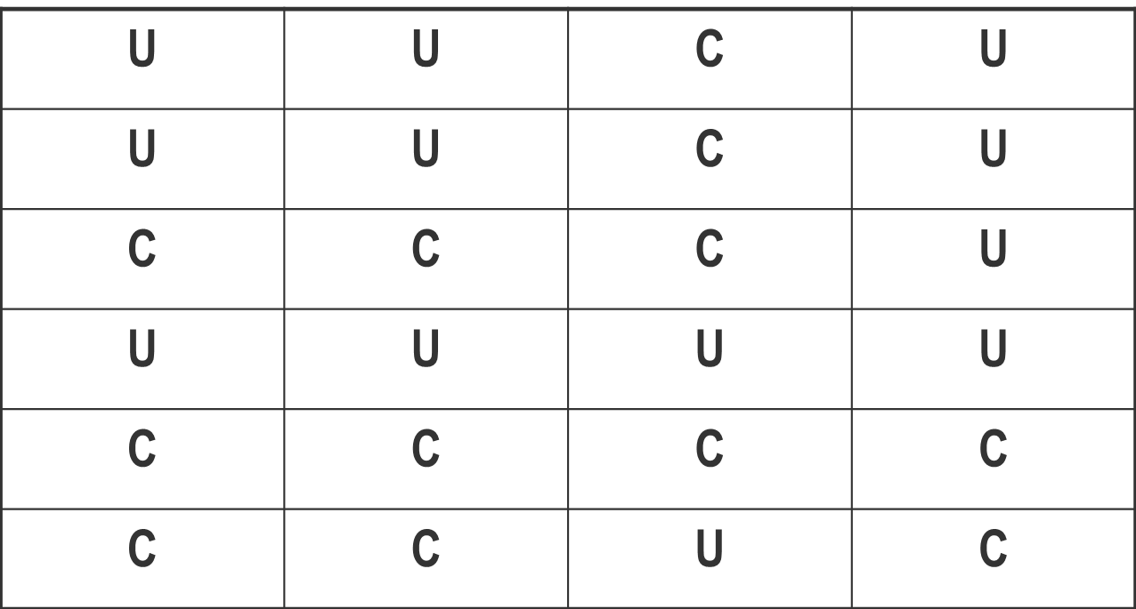
Answers

Slide 12


Slide 13

We use some in the affirmative with countable nouns in the plural, and with uncountable nouns.
EXAMPLES:
I WANT SOME APPLES
I WANT SOME CHEESE

Slide 14

We use any in the negative and the interrogative with both countable nouns, in the plural and uncountable nouns.
EXAMPLES:
Are there any bananas in the fridge?
There isn´t any ketchup at home.

Slide 15

We use a / an in all forms ( affirmative, negative, and interrogative) with countable nouns in the singular.
EXAMPLES:
There is a cat in the garage.
There isn´t a dog in the street.
Is there a goldfish in the aquarium?

Slide 16

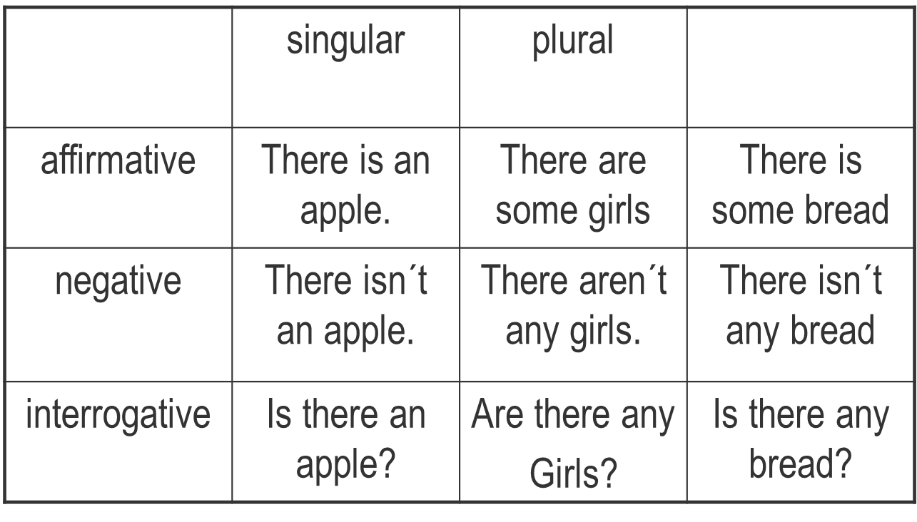

Slide 17
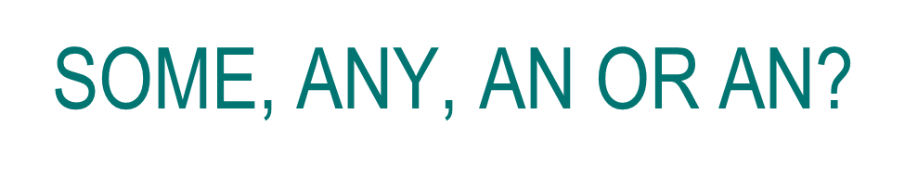
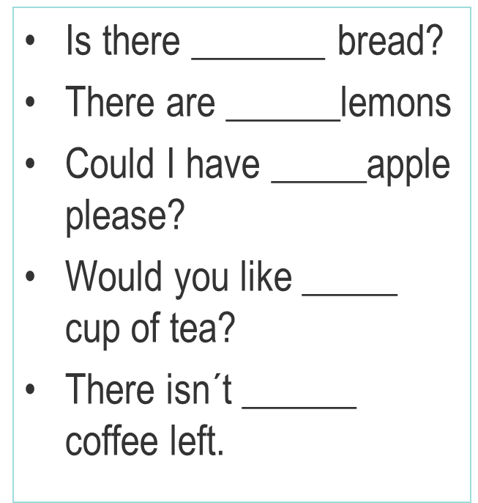
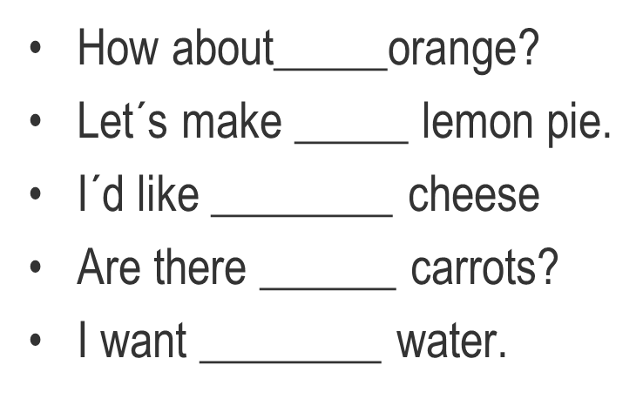

Slide 18

We use how much with uncountable nouns to ask about the amount of something.
E.g. How much butter do we need?
We use how many with countable nouns to ask about the number of things.
E.g. How many pupils are there in your class?

Slide 19
When do we use a little and when a few?
a little: non countable nouns
milk, marmalade, money, time etc.
a few: countable nouns
bottles of milk, jars of marmalade, dollars, minutes etc.
Examples:
He has a little money left.
He has a few dollars left.

Slide 20
When do we use much and many?
We use much with singular uncountable
nouns and many with plural nouns:
Examples:
I haven’t got much energy today.
Are there many trees your house?

Slide 21
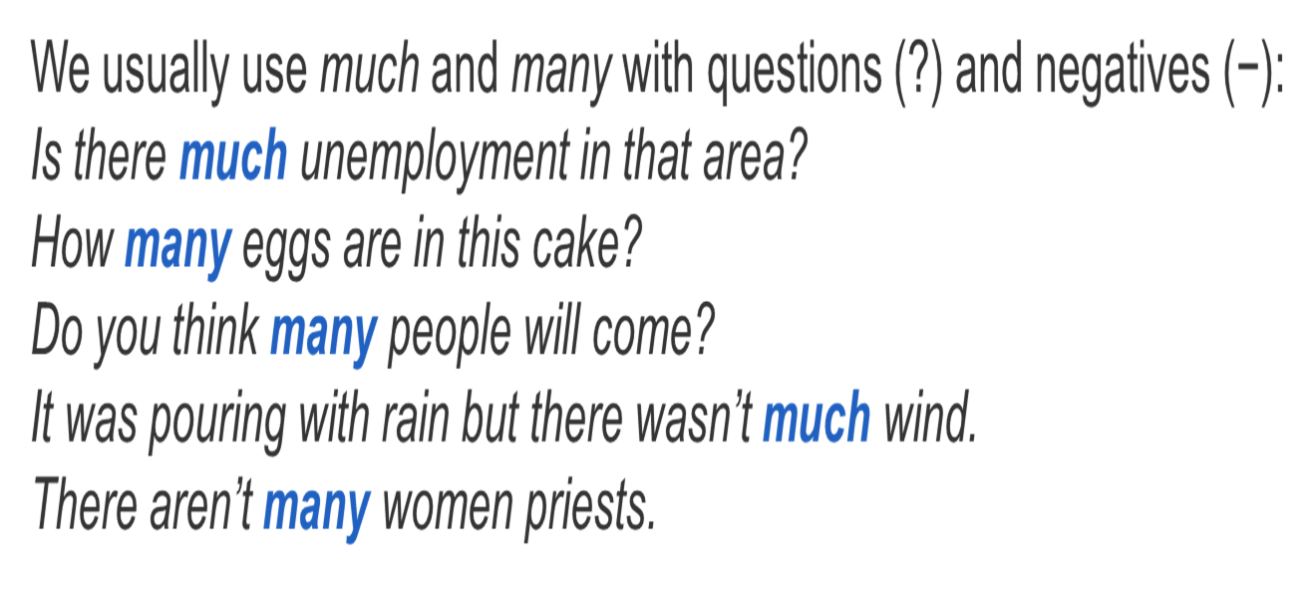

Slide 22
Affirmatives:
In affirmative clauses we sometimes use much and many in more formal styles.
There is much concern about drug addiction in the US.
He had watched many horror movies at home.
In informal styles, we prefer to use lots of or a lot of:
I went shopping and spent a lot of money
Not: I went shopping and spent much money

Slide 23
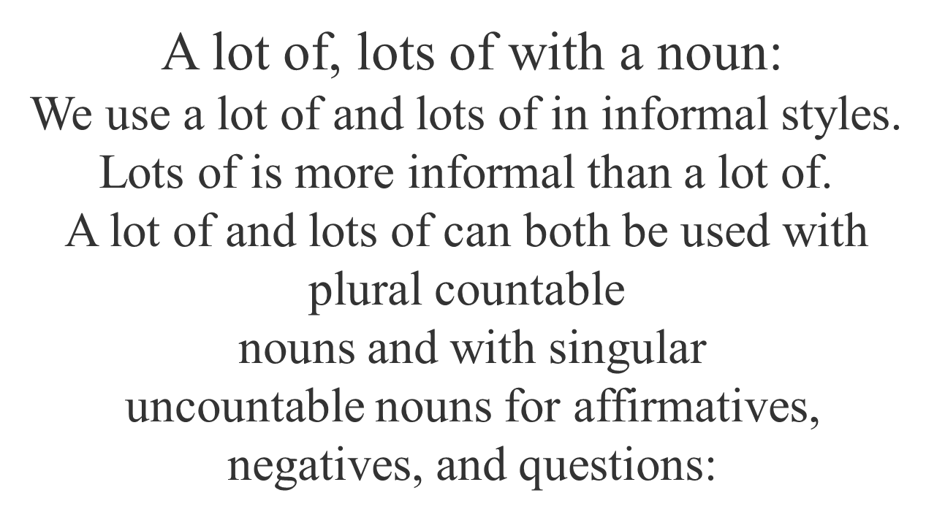

Slide 24
Examples:
We´ve got lots of thing to do.
That´s a lot of money.
There werent´s a lot of choices.
Can you hurry up? I don´t have a lot of time.
Are there a lot of good players at your tennis club?
Have you eaten lots of chocolate?

Slide 25
How much, how many, few or little a lot of?
________water do you drink everyday?
________ brothers and sisters do you have?
There are ________ students in the class today.
I have _________ milk in the refrigerator.
I need __________ apples to make the cake.
Excuse me, __________ does that jacket cbost?
A have __________, but __________ friends.
My sister has ___________ friends.

Slide 26
Referencias:
Maricela Cruz Márquez
Double Click 1 workbook and grammar book
Virginia Evans – Neil O´Sullivan
Express Publishing, 2005

